Slide 1


OCP 11 [1Z0-819]
Dr.-Ing Mohamed Amine Mezghich
Associate Professor at ENSI, CEO of Smart IT Partner
JAVA/J2EE Certified Trainer
ma.mezghich@smart-it-partner.com
amine.mezghich@ensi-uma.tn

Slide 2
Chapter 9 : NIO.2 Exam Essentials
1-Understand how to create and use Path objects. Using the NIO.2 API, an instance of a Path object can be created from the Paths factory class by passing a path String to the static method Paths.get(). The Path interface includes numerous instance methods for reading and manipulating the abstract path value.
2-Understand how to interact with Path objects using the Files API. The NIO.2 static Files helper class can be used to perform a variety of operations on a file or directory represented by a Path object, including creating directories, copying or moving a file/directory, deleting a file/directory, verifying that a file/directory exists, reading the contents of a file, and reading the metadata of a file or directory.

Slide 3
Chapter 8 : IO Exam Essentials
3-Be able to read and update file attributes using views. The NIO.2 API supports file views that can be used to retrieve or update file system–specific attributes of a file or directory. While the NIO.2 API includes support for various file systems, only the BasicFileAttributes and BasicFileAttributeView classes are required knowledge for the exam. The views are accessed in one of two ways from the Files helper class: a read-only attribute set and an updateable view. Accessing all of the file properties in a single call is more performant in most file systems than accessing them one at a time.

Slide 4
Chapter 8 : IO Exam Essentials
4-Be able to read files using lambda expressions. When Java 8 was updated with functional programming, the NIO.2 API gained four new methods for reading file data using lambda expressions and Stream instances in a lazy manner. The Files.walk() method traverses a directory tree in a depth-first manner. The Files.find() method traverses a directory finding those paths that match a specific set of search criteria. The Files.list() method retrieves the contents of a single directory level and makes them available as a stream. Finally, the Files.lines() method reads all of the lines in a file and processes them as they are read.

Slide 5
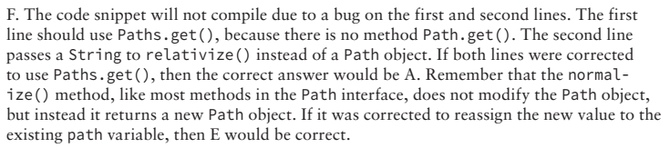
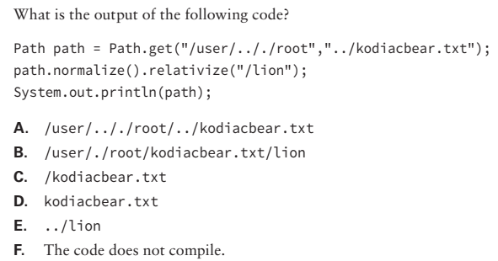
Chapter 8 : NIO.2 Review Questions
Q1)

Slide 6
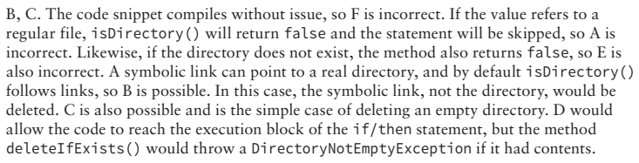
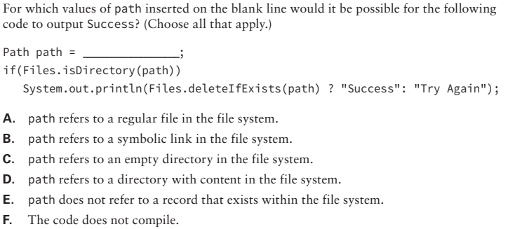
Chapter 8 : NIO.2 Review Questions
Q2)

Slide 7

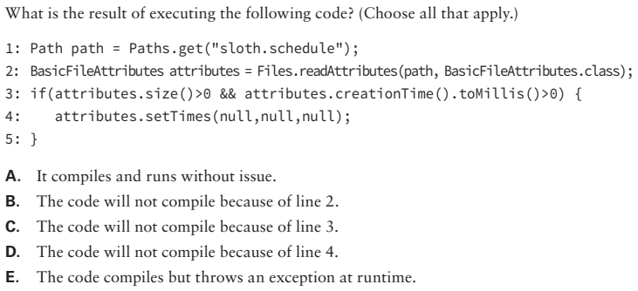
Chapter 8 : NIO.2 Review Questions
Q3)

Slide 8
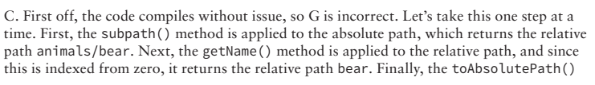
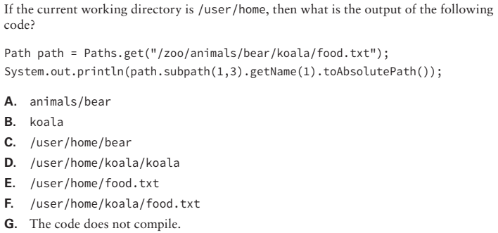
Chapter 8 : NIO.2 Review Questions
Q4)

Slide 9
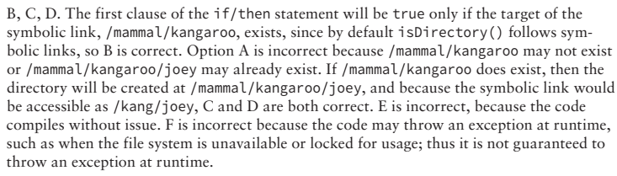
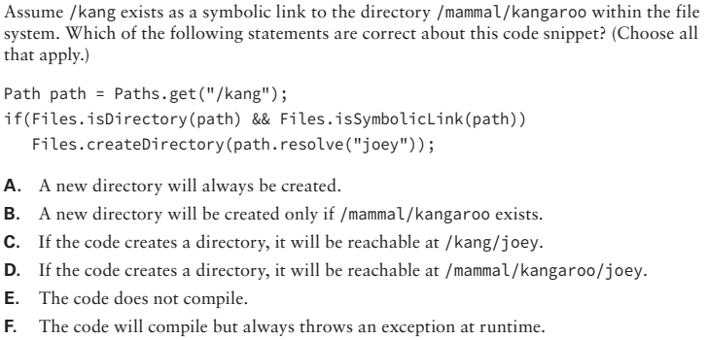
Chapter 8 : NIO.2 Review Questions
Q5)

Slide 10
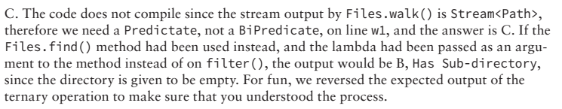
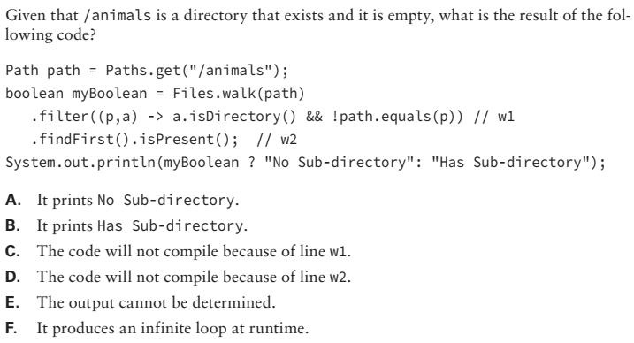
Chapter 8 : NIO.2 Review Questions
Q6)

Slide 11
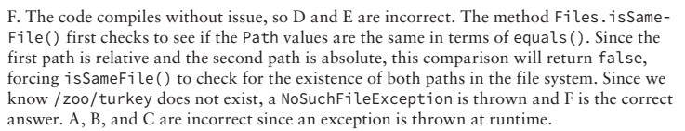
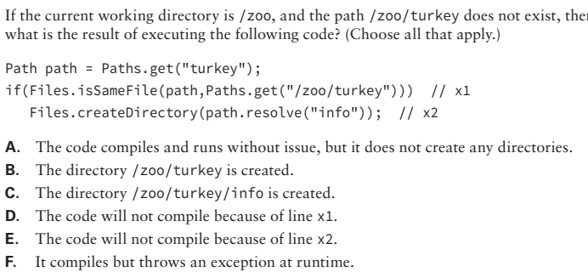
Chapter 8 : NIO.2 Review Questions
Q7)

Slide 12
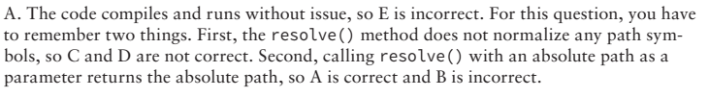
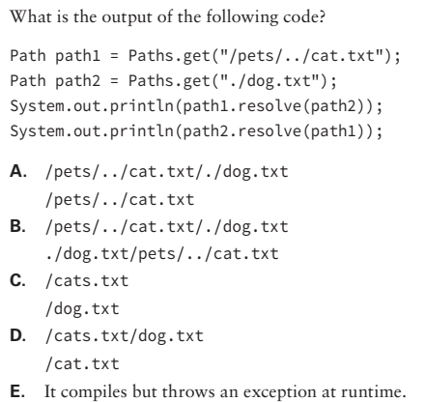
Chapter 8 : NIO.2 Review Questions
Q8)

Slide 13
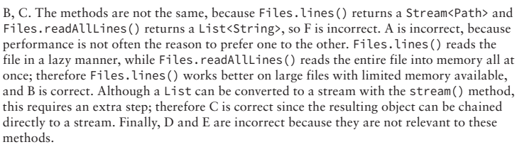
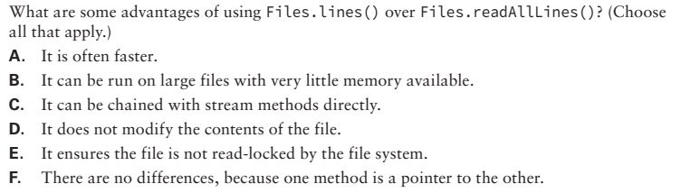
Chapter 8 : NIO.2 Review Questions
Q9)

